Slide 1
App Development
This work is licensed under a Creative Commons Attribution-NonCommercial 4.0 International License

Slide 2
What is an Android app?
One or more interactive screens
Written using Java Programming Language and XML
Uses the Android Software Development Kit (SDK)
Uses Android libraries and Android Application Framework
Executed by Android Runtime Virtual machine (ART)

Slide 3
Challenges of Android development
Multiple screen sizes and resolutions
Performance: make your apps responsive and smooth
Security: keep source code and user data safe
Compatibility: run well on older platform versions
Marketing: understand the market and your users (Hint: It doesn't have to be expensive, but it can be.)

Slide 4
App building blocks
Resources: layouts, images, strings, colors as XML and media files
Components: activities, services, …, and helper classes as Java code
Manifest: information about app for the runtime
Build configuration: APK versions in Gradle config files

Slide 5
Component types
Activity is a single screen with a user interface
Service performs long-running tasks in background
Content provider manages shared set of data
Broadcast receiver responds to system-wide announcements

Slide 6
Think of Android as a hotel
Your app is the guest
The Android System is the hotel manager
Services are available when you request them (intents)
In the foreground (activities) such as registration
In the background (services) such as laundry
Calls you when a package has arrived (broadcast receiver)
Access the city's tour companies (content provider)

Slide 7
Prerequisites
Java Programming Language
Object-oriented programming
XML - properties / attributes
Using an IDE for development and debugging

Slide 8
Installation Overview
Mac, Windows, or Linux
Requires Java Development Kit (JDK) 1.7 or better from Oracle Java SE downloads page
Set JAVA_HOME to JDK installation location
Download and install Android Studio from http://developer.android.com/sdk/index.html
See 1.1 P Install Android Studio for details

Slide 9
Creating Your First Android App
This work is licensed under a Creative Commons Attribution-NonCommercial 4.0 International License

Slide 10
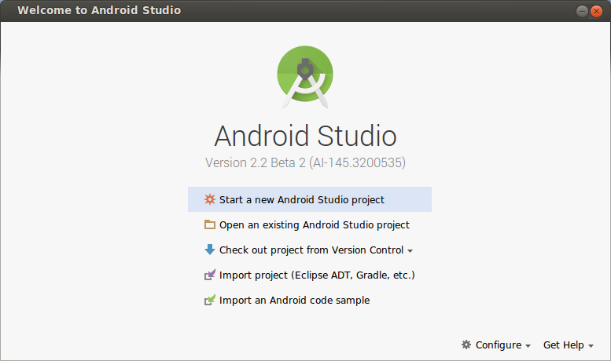

Start Android Studio

Slide 11
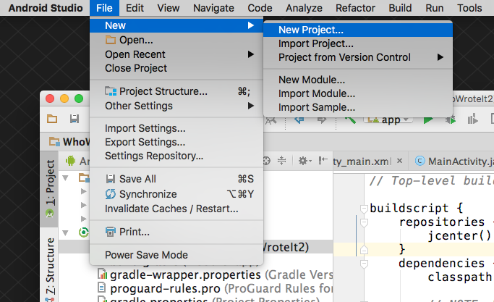
Create a project inside Android Studio

Slide 12
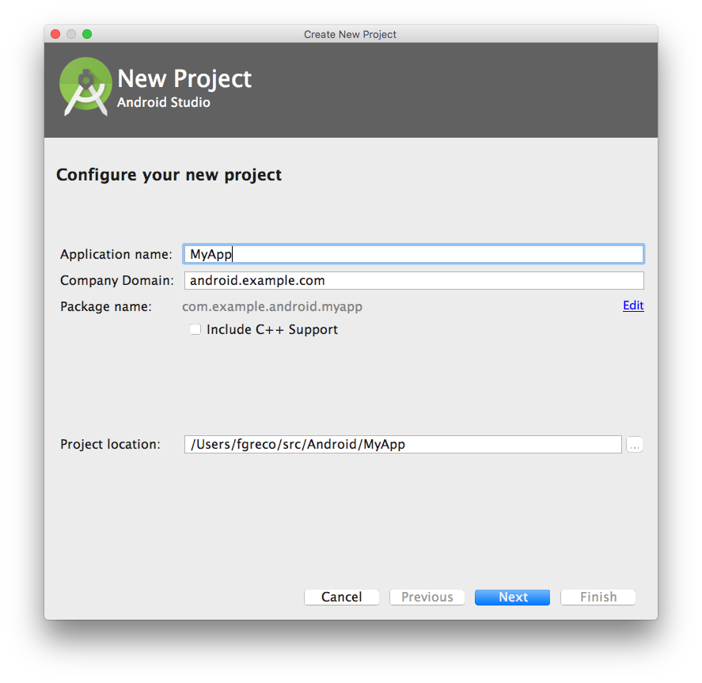
Name your app

Slide 13
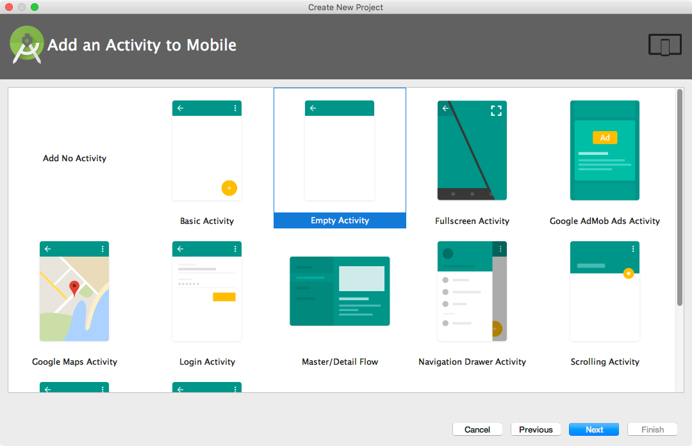
Pick activity template
Choose templates for common activities, such as maps or navigation drawers.
Pick Empty Activity or Basic Activity for simple and custom activities.

Slide 14
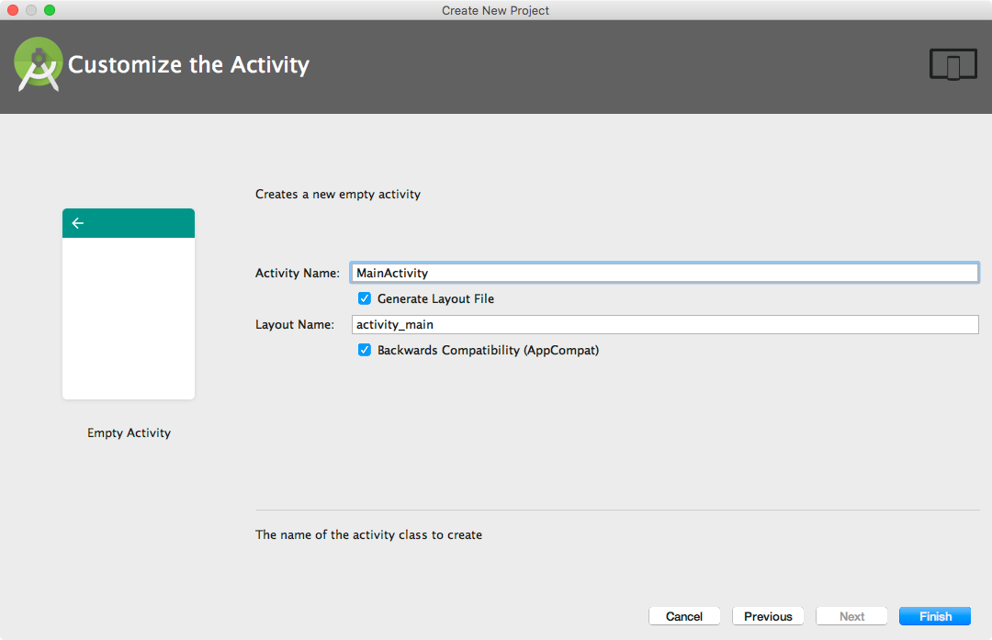
Name your activity
Good practice to name main activity MainActivity and activity_main layout
Use AppCompat
Generating layout file is convenient

Slide 15
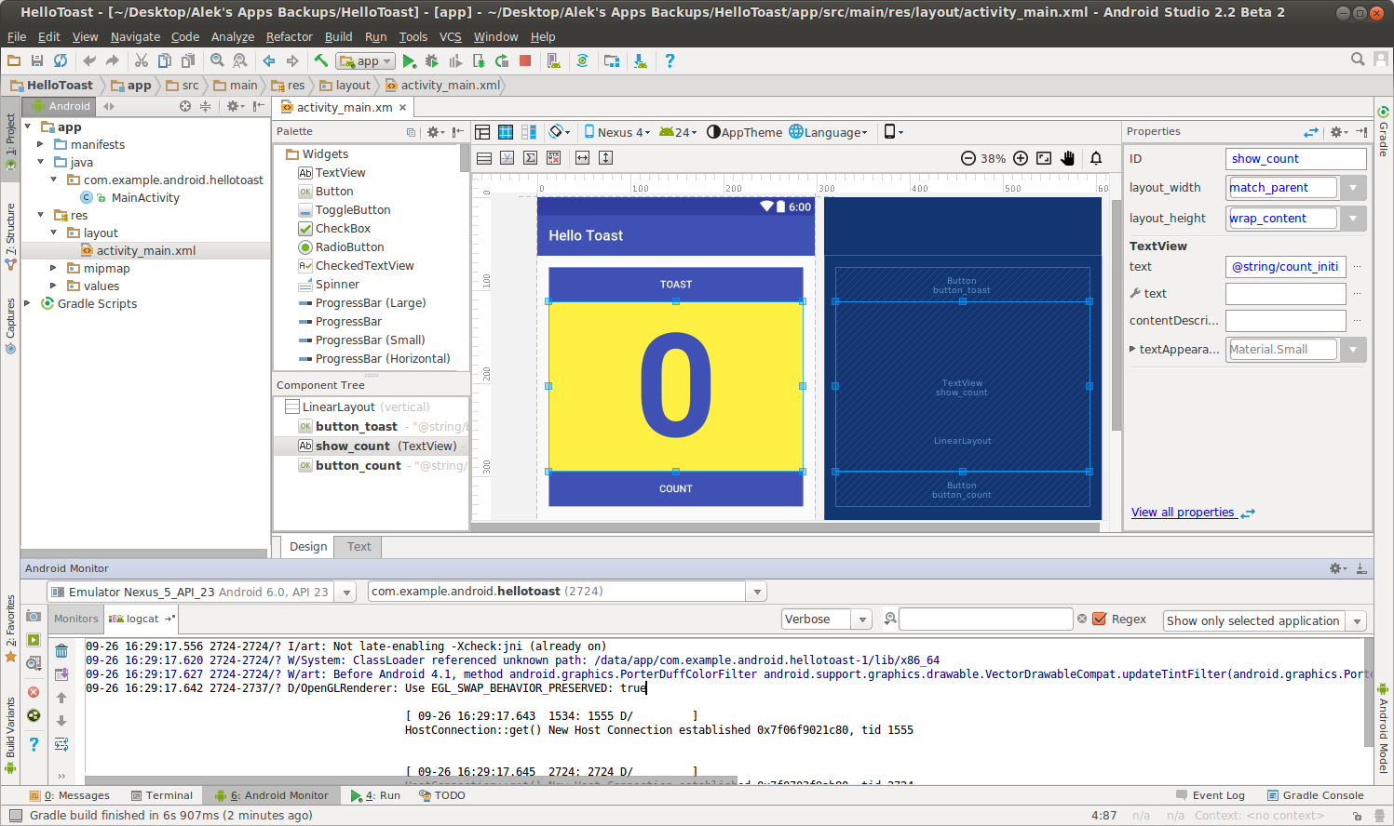
Android Studio Panes
Layout Editor
Project
Files
Android Monitors:
logcat: log messages

Slide 16
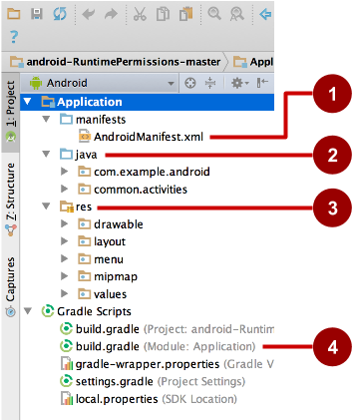
Project folders
manifests—Android Manifest file - description of app read by the Android runtime
java—Java source code packages
res—Resources (XML) - layout, strings, images, dimensions, colors...
build.gradle—Gradle build files

Slide 17
Gradle build system
Modern build subsystem in Android Studio
Three build.gradle:
project
module
settings
Typically not necessary to know low-level Gradle details
Learn more about gradle at https://gradle.org/

Slide 18
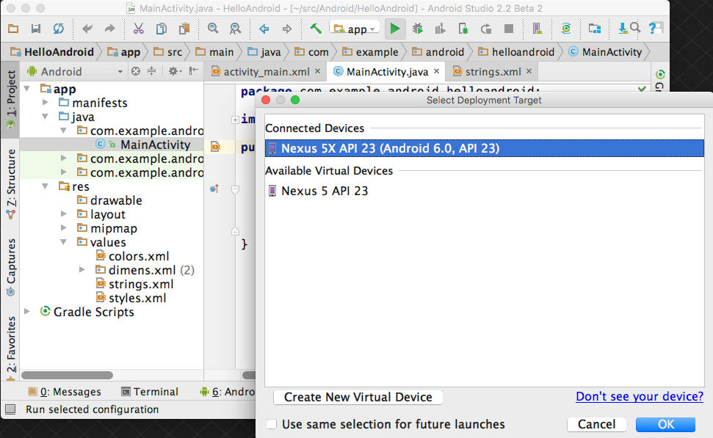
Run your app
Run
2. Select virtual or physical device
3. OK

Slide 19
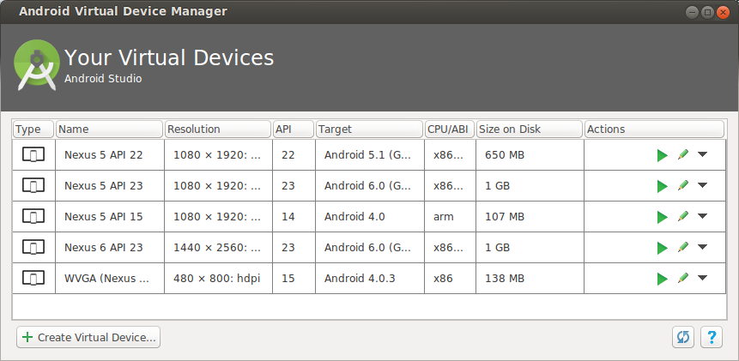
Create a virtual device
Use emulators to test app on different versions of Android and form factors.
Tools > Android > AVD Manager or:

Slide 20
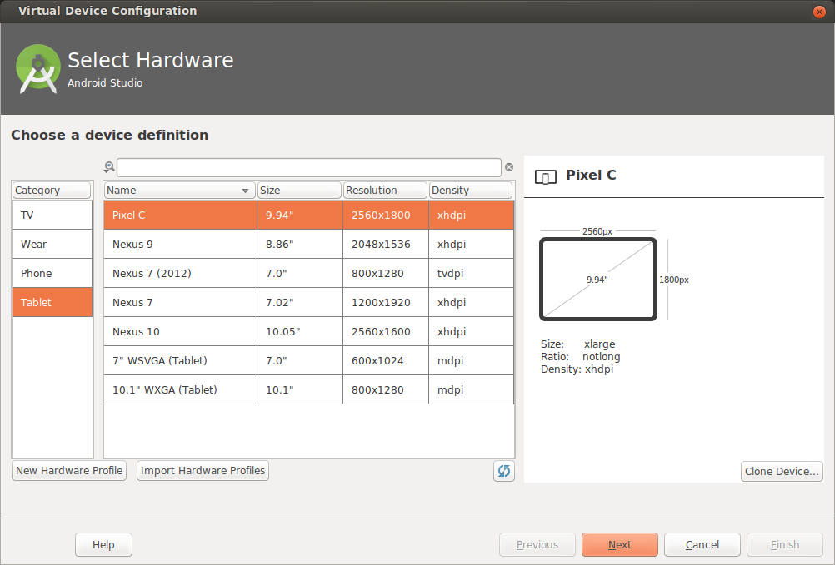
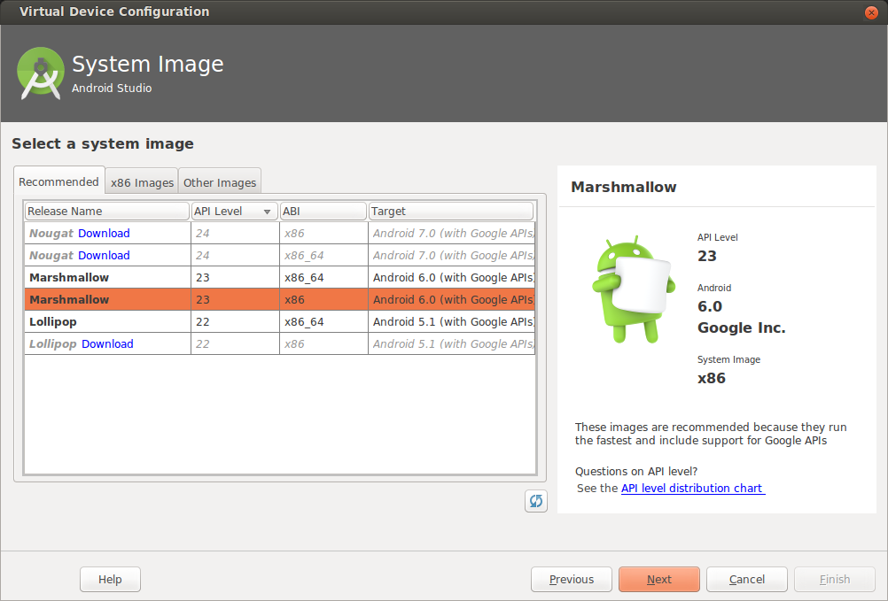
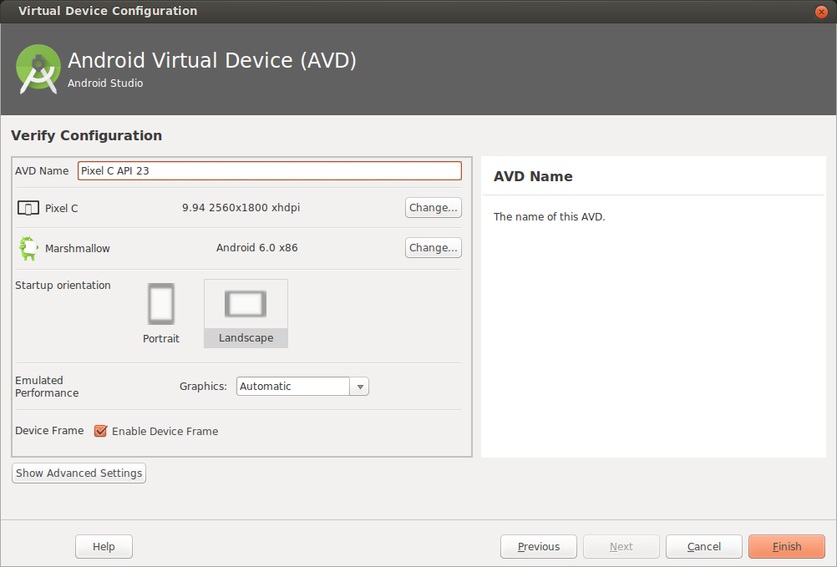
Configure virtual device
Choose hardware
2. Select Android Version
3. Finalize

Slide 21
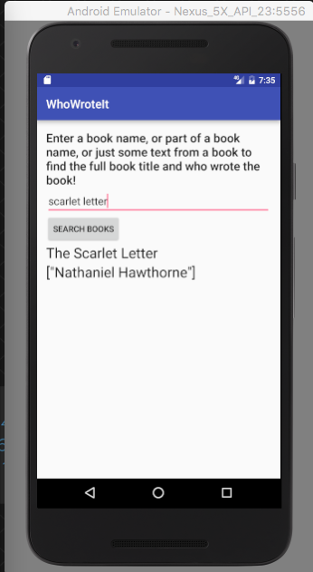

Run on a virtual device

Slide 22
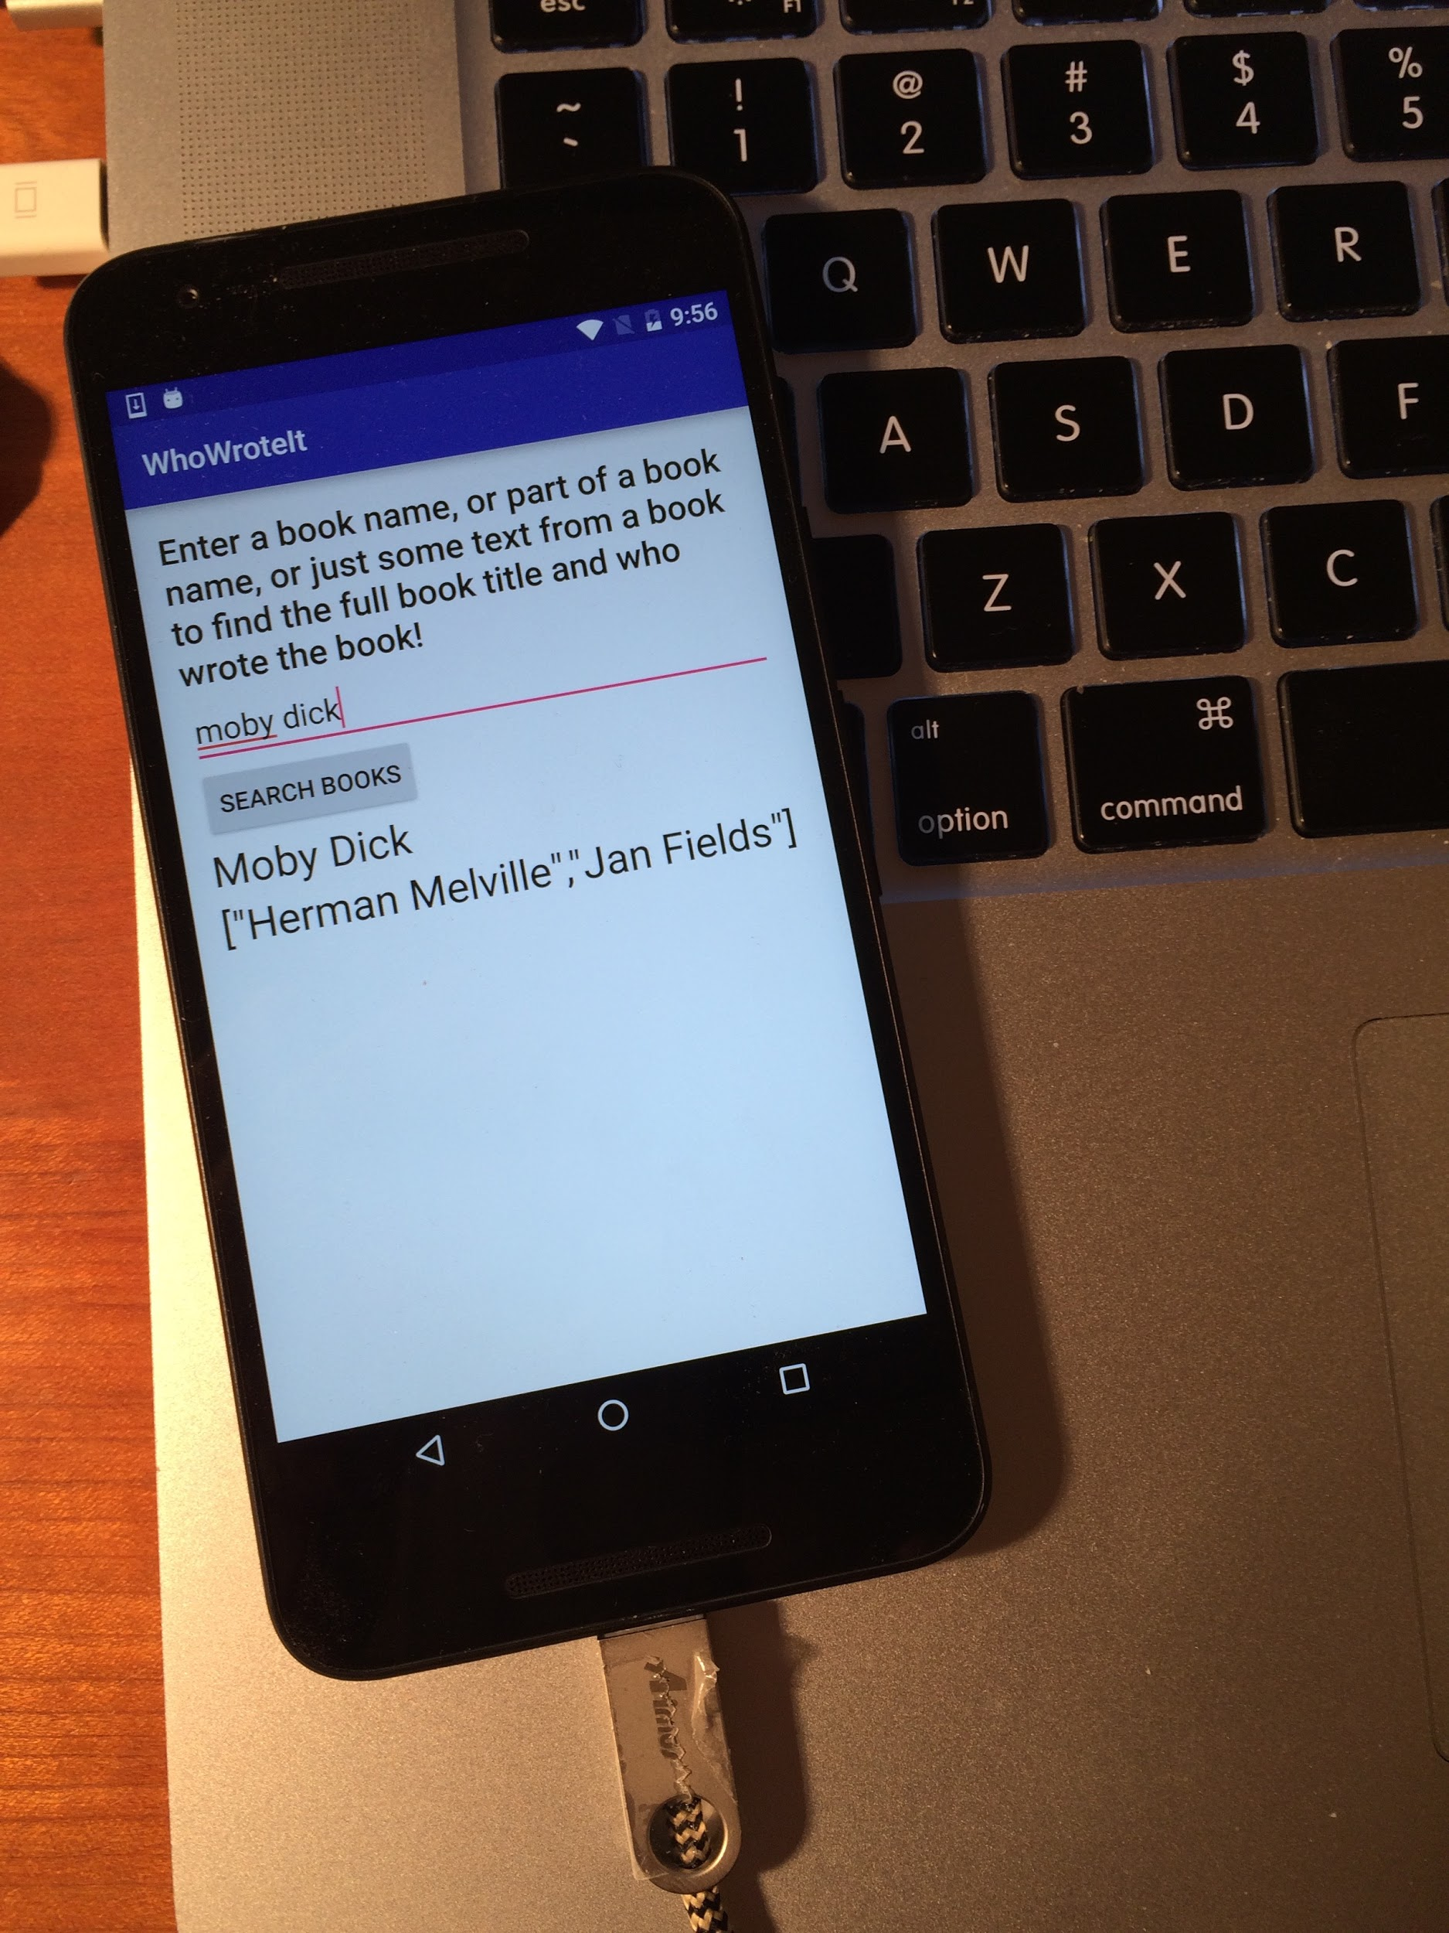
Run on a physical device
Turn on Developer Options:
Settings > About phone
Tap Build number seven times
Turn on USB Debugging
Settings > Developer Options > USB Debugging
Connect phone to computer with cable
Windows/Linux additional setup:
Using Hardware Devices
Windows drivers:
OEM USB Drivers

Slide 23
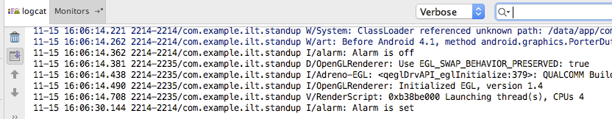
Get feedback as your app runs
As the app runs, Android Monitor logcat shows information
You can add logging statements to your app that will show up in logcat.

Slide 24
Logging
import android.util.Log;
// Use class name as tag
private static final String TAG = MainActivity.class.getSimpleName();
// Show message in Android Monitor, logcat pane
// Log.<log-level>(TAG, "Message");
Log.d(TAG, “Creating the URI…”);

Slide 25
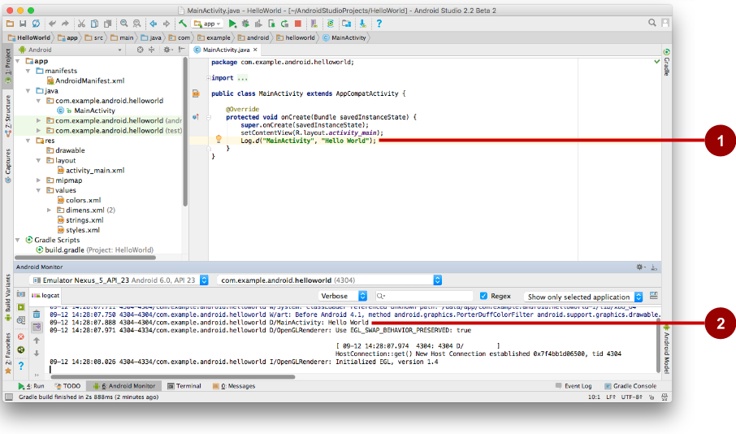
Android Monitor > logcat pane
Log statements in code.
logcat pane shows system and logging messages
Set filters to see what's important to you
Search using tags

Slide 26
Learn more
Meet Android Studio
Official Android documentation at developer.android.com
Create and Manage Virtual Devices
Supporting Different Platform Versions
Supporting Multiple Screens

Slide 27
Learn even more
Gradle Wikipedia page
Google Java Programming Language style guide
Find answers at Stackoverflow.com

Slide 28
What's Next?
Concept Chapter: 1.1 C Create Your First Android App
Practical: 1.1 P Install Android Studio and Run Hello World

Slide 29
END

